Slide 1



SESSION NAME HERE
HASH TABLES

Slide 2


Foundational Sessions Housekeeping
The use of disrespectful language is prohibited in the questions, this is a supportive, learning environment for all - please engage accordingly. (FBV: Mutual Respect.)
No question is daft or silly - ask them!
There are Q&A sessions midway and at the end of the session, should you wish to ask any follow-up questions. Moderators are going to be answering questions as the session progresses as well.
If you have any questions outside of this lecture, or that are not answered during this lecture, please do submit these for upcoming Open Classes. You can submit these questions here:
SE Open Class Questions or DS Open Class Questions

Slide 3
Foundational Sessions Housekeeping cont.
For all non-academic questions, please submit a query: www.hyperiondev.com/support
Report a safeguarding incident: www.hyperiondev.com/safeguardreporting
We would love your feedback on lectures: Feedback on Lectures

Slide 4


Reminders!
Guided Learning Hours
By now, ideally you should have 7 GLHs per week accrued. Remember to attend any and all sessions for support, and to ensure you reach 112 GLHs by the close of your Skills Bootcamp.
CONFIDENTIAL

Slide 5
Progression Criteria
✅ Criterion 1: Initial Requirements
Complete 15 hours of Guided Learning Hours and the first four tasks within two weeks.
✅ Criterion 2: Mid-Course Progress
Software Engineering: Finish 14 tasks by week 8.
Data Science: Finish 13 tasks by week 8.
✅ Criterion 3: Post-Course Progress
Complete all mandatory tasks by 24th March 2024.
Record an Invitation to Interview within 4 weeks of course completion, or by 30th March 2024.
Achieve 112 GLH by 24th March 2024.
✅ Criterion 4: Employability
Record a Final Job Outcome within 12 weeks of graduation, or by 23rd September 2024.
CONFIDENTIAL

Slide 6


What is the primary purpose of a hash function in a hash table?
To encrypt data.
To map data to unique hash codes.
To sort data in ascending order.
To reduce data size.

Slide 7
What is a hash collision?
A security breach in a hash table.
When two different inputs produce the same hash code.
A failure in the hash function.
A type of data compression.

Slide 8
How do Python dictionaries primarily store and access data?
Using a list-based structure.
Through a tree structure.
Using a hash table mechanism.
Via direct indexing.

Slide 9

Recap of Linear Data Structures

Slide 10

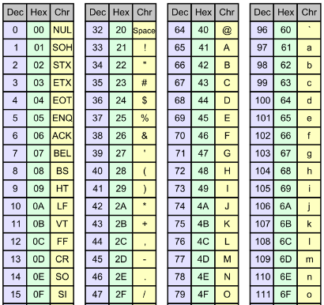
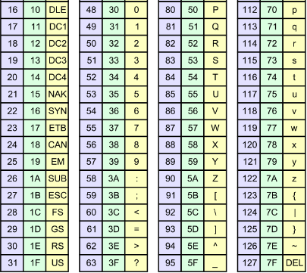
ASCII
ASCII is a character encoding standard used for electronic communication, representing text in computers and other devices with limited set of 128 code points

Slide 11
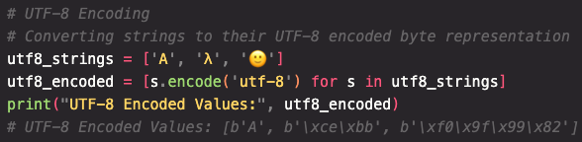
Unicode
Unicode is a universal encoding system that allows the representation of a comprehensive character set, including those required for global multilingual text processing
UTF-8, a popular Unicode format, encodes characters using 1 to 4 bytes, providing efficient data representation.

Slide 12

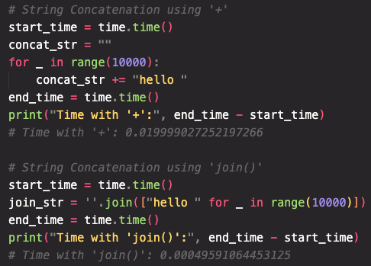
String Concatenations in Python
Strings in Python are immutable:
'+' creates a new string by copying each character
Time complexity: O(n²)
join creates a new string by copying characters of one string
Time complexity: O(n)

Slide 13

Hash Tables Topics
Introduction to Hash Tables
Hash Collisions
Implementing a Hash Table
Comparing Hash Tables and Dictionaries

Slide 14
Efficient Spell-Checkers
Consider spell-checking tools which are used on your devices. Suggestions and corrections need to be made as you are typing so correct spellings of words need to be looked up very quickly. A data structure containing pairs of common incorrect spelled words and the correct spelling, but this structure would be very big.
What data structure can be used that will allow us to create such a big data structure efficiently and quickly?
How can we store these pairs of words in a way that ensures that our data structure can be searched and common misspellings looked up and the correct spellings retrieved very quickly ?

Slide 15
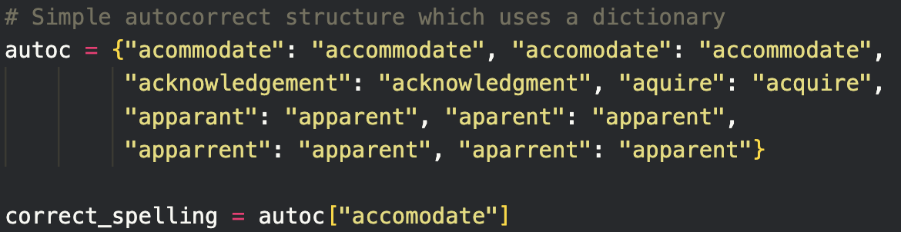
Example: Dictionaries in Python
The data structure known as a dictionary is a data structure that can easily solve our problem. In a dictionary, key-value pairs are stored and values are accessed using the key value.
It turns out that this data structure is very efficient, but how does it work? How is it so efficient?

Slide 16
Hash Tables
A data structure that is used to store key-value pairs which uses a hash function to transform the key into the index of an associated array element where the data will be stored.
Hash tables allow for efficient and fast insertions, deletions and look-ups due to the manner in which values are stored.
Since the index where the values is stored is a function of the value, the position where the value must be stored is always known.
key1
key2
key3
key4
key5
0
1
2
3
4
hash fn
Notes:
Note that hash functions may be one-way (hash doesn’t generate the original data item) which is important in cryptography

Slide 17
Hashing refers to using the hash function to calculate the hash which is the index of the array element where the key-value pair will be stored.
Each array element is called a bucket or slot and can store one or more key-value pairs.
The hash function can be any deterministic function which maps a key to the range of indices but the aim is that the function is efficient, it distributes keys uniformly and multiple keys being mapped to the same index is avoided.
The load factor is the ratio of the number of stored elements to the total number of buckets and is used to determine whether the table can be downsized to improve performance.
Notes:
Last two + hash collisions are the deciding factors when it comes to time complexities
Demo: https://www.md5online.org, insert a text of any length in the textbox, click the crypt button and get your 128bit MD5 hash back.

Slide 18
Hash Collisions
When two or more distinct keys hash to the same array index.
Although we try to avoid hash collisions, they are inevitable so we have to implement a collision-resolution process.
When searching or storing data, a hash collision increases the time complexity of the task.
Operation | Average Case | Worst Case
Insert | O(1) | O(n)
Lookup/Search | O(1) | O(n)
Delete | O(1) | O(n)

Slide 19
Collision-Resolution Methods
Chaining: Linked Lists are used for each bucket, so multiple key-value pairs can be stored in the same bucket.
Pros: Simple to implement, dynamic resizing
Cons: Memory overhead implications, space inefficiencies
Linear Probing: If there is a collision, place the pair in the next available slot in the hash table (linearly).
Pros: Simple to implement, memory-efficient
Cons: Primary clustering (large blocks of occupied elements), clustering results in more time inefficiencies

Slide 20
Hash Tables vs Dictionaries
Dictionaries are data structures which store key-value pairs.
They are implemented internally using a hash table, which makes use of Python’s built-in hash function.
Dictionaries are the easiest way to implement a hash table in Python, since all the complexities involved in ensuring efficiency is abstracted away and is done for us.
A custom hash table would be primarily used when a custom hash function needs to be implemented.
This is useful in the case where keys are of custom or non-hashable data types.

Slide 21
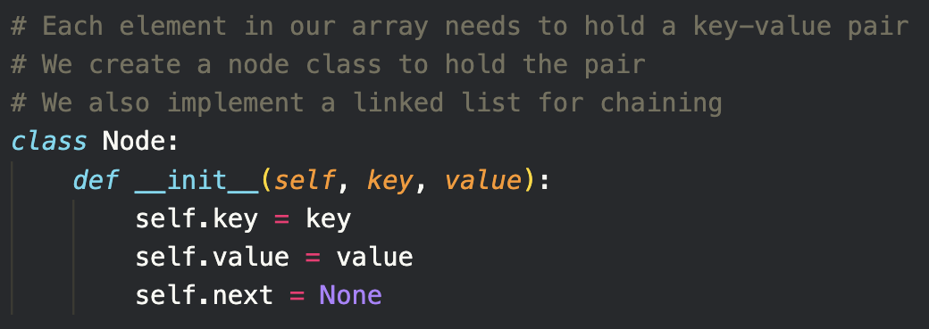
Hash Table Implementation
For this implementation, we’ll use chaining to handle hash collisions. We use a numpy array to store an array of Nodes containing the key-value pairs.

Slide 22
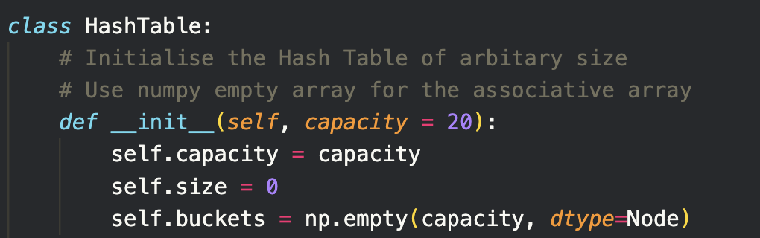
Hash Table Implementation
For maximum efficiency, we should constantly resize the hash table based on the load but we haven’t included that in our implementation since we’ll be using the hash table for small datasets.
Note:

Slide 23
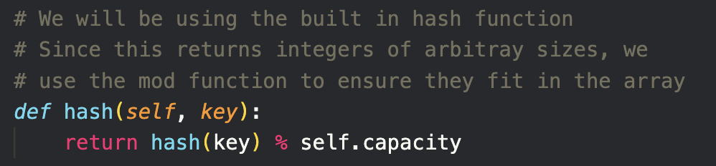
Hash Table Implementation
We will be using the built-in hash function since our key value is not an Object type and the hash function sufficiently spreads the elements.
We implement three functions: set, get and remove. Other useful functions we might want to implement as well include a resize and print function.

Slide 24
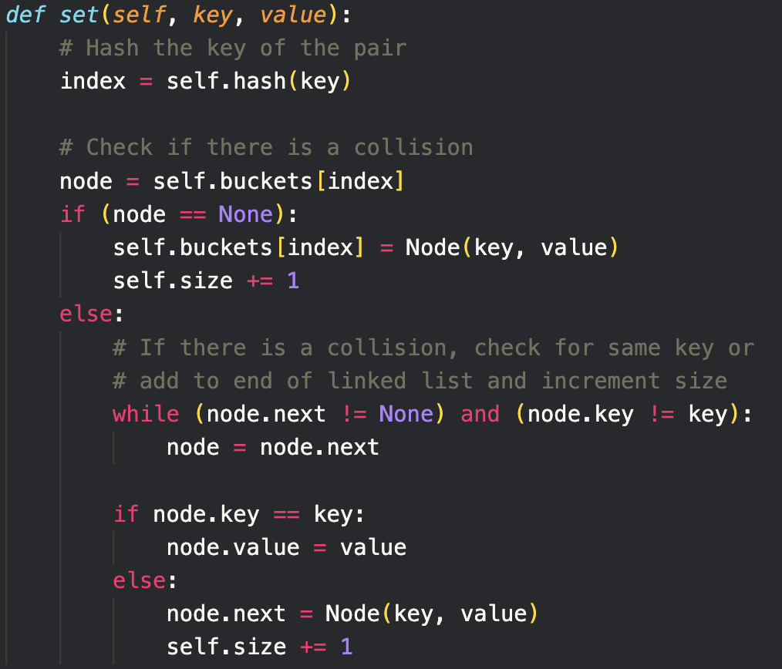

Slide 25
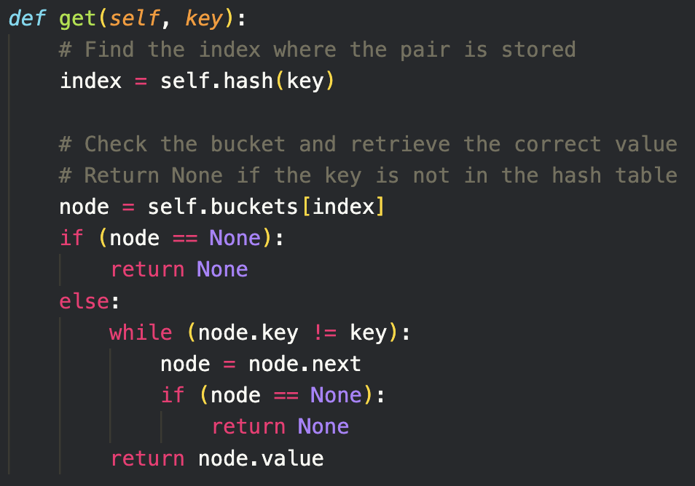

Slide 26
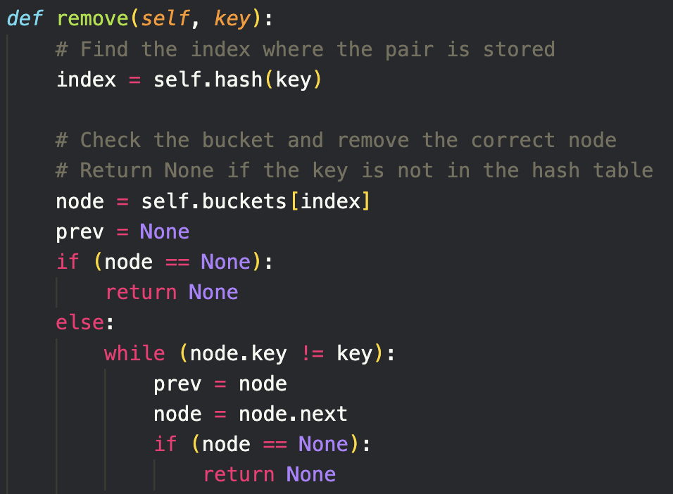
To remove elements, first we find the correct element. The code is the same as a get function.

Slide 27
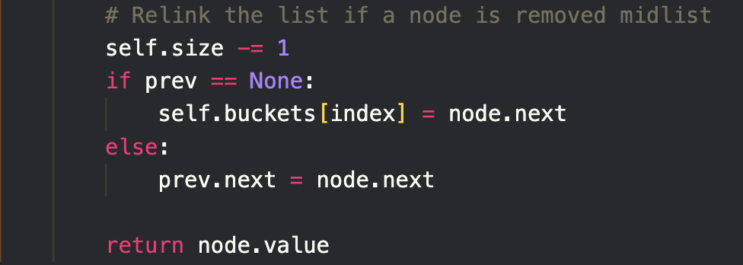
Next, we remove the element and ensure the linked list is entact.

Slide 28
Worked Example
How would you use the Hash Table data structure to store recently accessed data files in cache?
What would be the best way to remove items from the cache when the cache is full?
Describe the process of fetching a file from the disk, including the caching mechanism.
Implement a memory cache using a Hash Table.
Consider a simple memory cache to store recently accessed files from a disk.
How could we use a Hash Table to implement a memory cache that allows us to access a few recently accessed files faster and more efficiently?

Slide 29
Worked Example
How would you use the Hash Table data structure to store recently accessed data files in cache?
After a file is read from the disk, use the set function of the Hash Table to store the data in the cache. The key would be the name of the data file.
What would be the best way to remove items from the cache when the cache is full?
Most memory caches work on a least recently used basis. For this to work, the best collision resolution method would be linear probing.
Describe the process of fetching a file from the disk, including the caching mechanism.
Check if the file is in the cache (using the get method), if it’s not fetch it from the disk then store it in the cache (using the set method).
Consider a simple memory cache to store recently accessed files from a disk.
How could we use a Hash Table to implement a memory cache that allows us to access a few recently accessed files faster and more efficiently?

Slide 30
Worked Example
4. Implement a memory cache using a Hash Table.
An example of how this can be implemented can be found in the source code for this lecture.
Consider a simple memory cache to store recently accessed files from a disk.
How could we use a Hash Table to implement a memory cache that allows us to access a few recently accessed files faster and more efficiently?

Slide 31
Summary
Hash Tables
Data structure which stores key-value pairs efficiently using a hash function to determine the index of an array where the pair will be stored
Hash functions have to be deterministic and simple to compute
Hash Collisions
When the hash function maps a pair to an element where a pair has already been stored, this is known as a hash collision
Hash collisions can be handled using linear probing or chaining
Dictionaries
Dictionaries in Python are implemented using a hash table which makes use of the built-in hash function.

Slide 32
Further Learning
Hash Tables - Section in the textbook “Algorithms” by Robert Sedgewick and Kevin Wayne
Introduction to Hash Tables - Specifically for DS students
Comprehensive overview of Hash Tables - Goes over all the topics covered as well as providing links to find out more
Hash Tables in Python - Theory and Implementation of Hash Table in Python

Slide 33
What is a common method to resolve hash collisions?
Linear probing.
Increasing the hash table size.
Encrypting the hash codes.
Sorting the buckets.

Slide 34
When would a custom hash table implementation be preferred over a Python dictionary?
For smaller datasets.
For greater control over collision handling.
When using non-hashable data types.
For automatic memory management.

Slide 35
Questions and Answers
Questions around Hash Tables

